Slide 1
Assembly Coordinate System

Slide 2
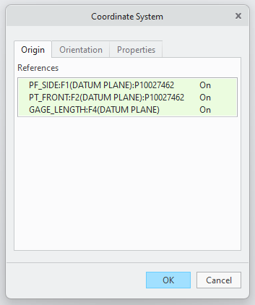
Editing Coordinate System
Select Coordinate System in "Model Tree" Dialog Box (Boxed in red)
Model Tab > Datum Ribbon > Coordinate System
Name > DYNAMIC_CSYS

Slide 3
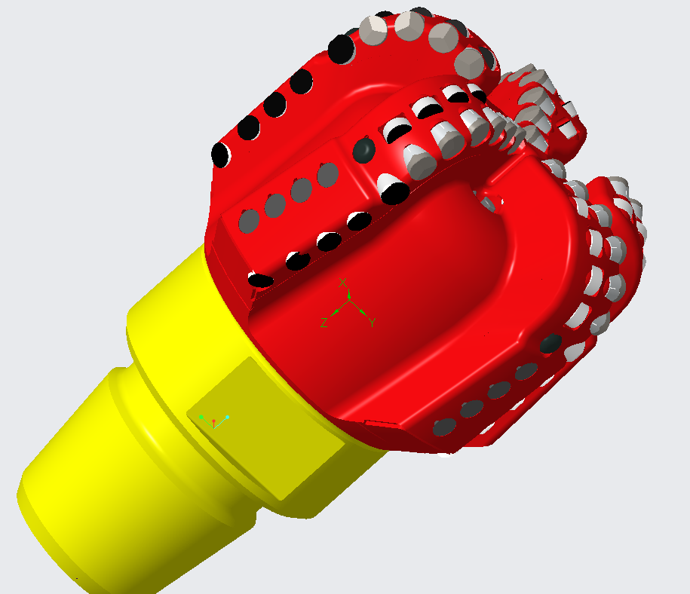
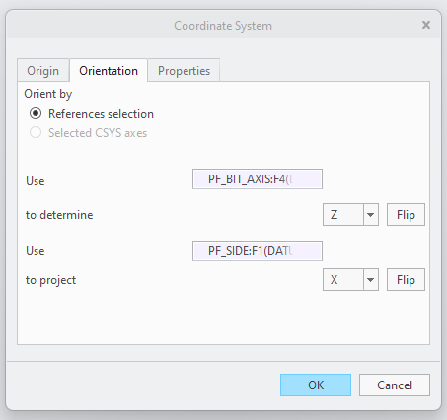
Orienting Coordinate System
Set Orientation Objects
Match Axis Orientation as shown (Use Flip)
X axis oriented parallel to blade 1 face
Y axis oriented down when X axis due right
Z axis oriented to drillstring

Slide 4
Part Coordinate System

Slide 5
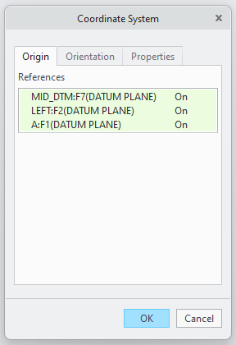
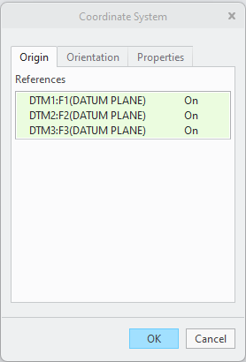
Creating Coordinate System / Setting Origin
Select Parts (Boxed in red depending on "Body 1" elements)
Model Tab > Datum Ribbon > Coordinate System
Name > DYNAMIC_CSYS

Slide 6
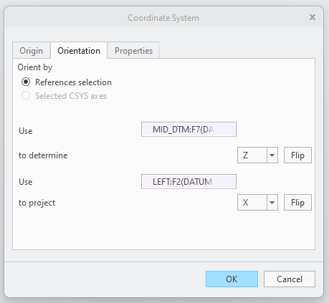
Orienting Coordinate System
Set Orientation Objects
Match Axis Orientation as shown on next slides (Use Flip)
X axis set normal to cutter face
Y axis pointing to right when looking into X axis with Z axis pointing up
Z axis set normal to cutting contact point

Slide 7
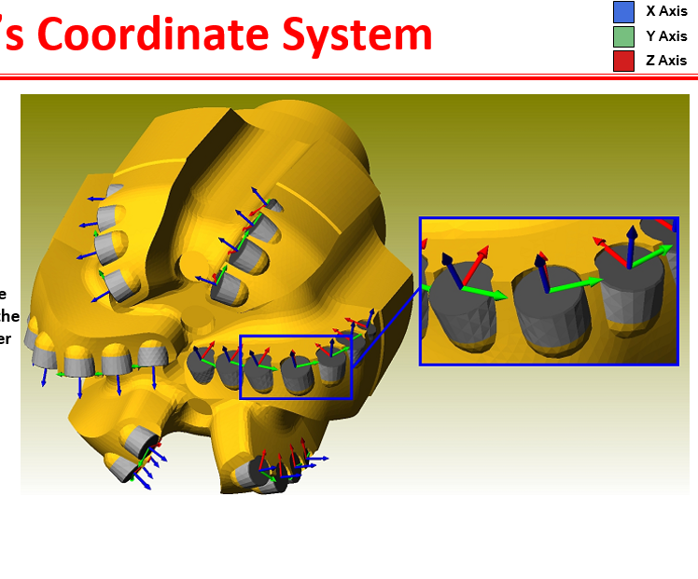

Slide 8
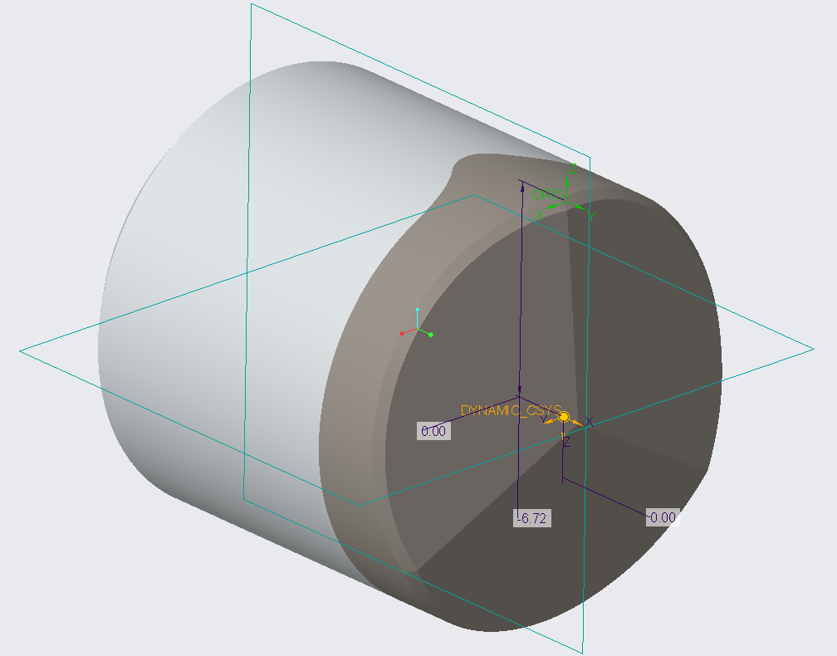
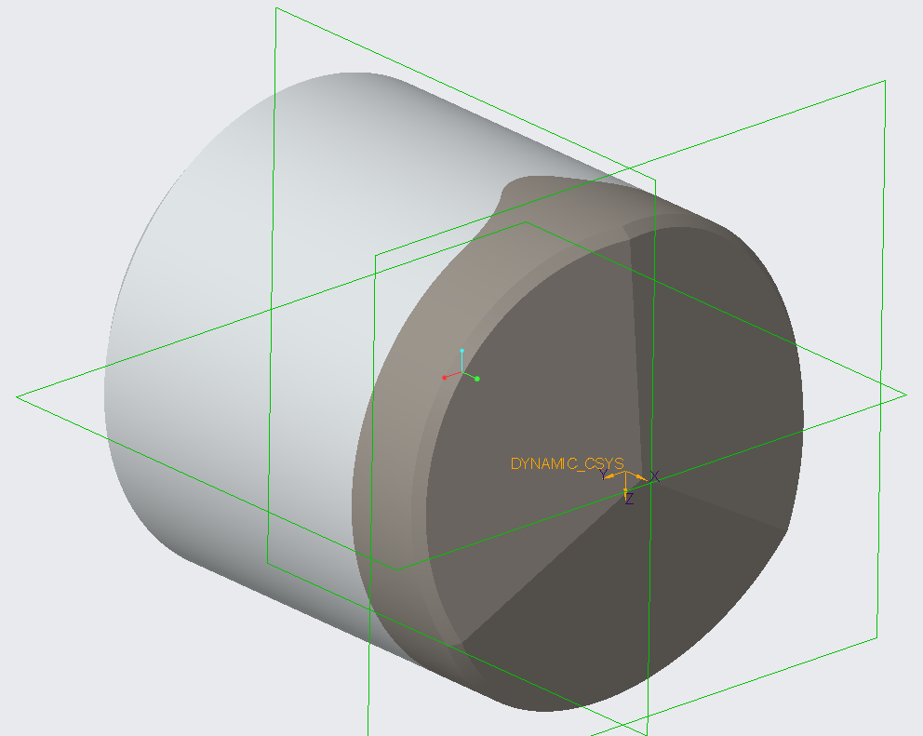

Slide 9
Tagging

Slide 10
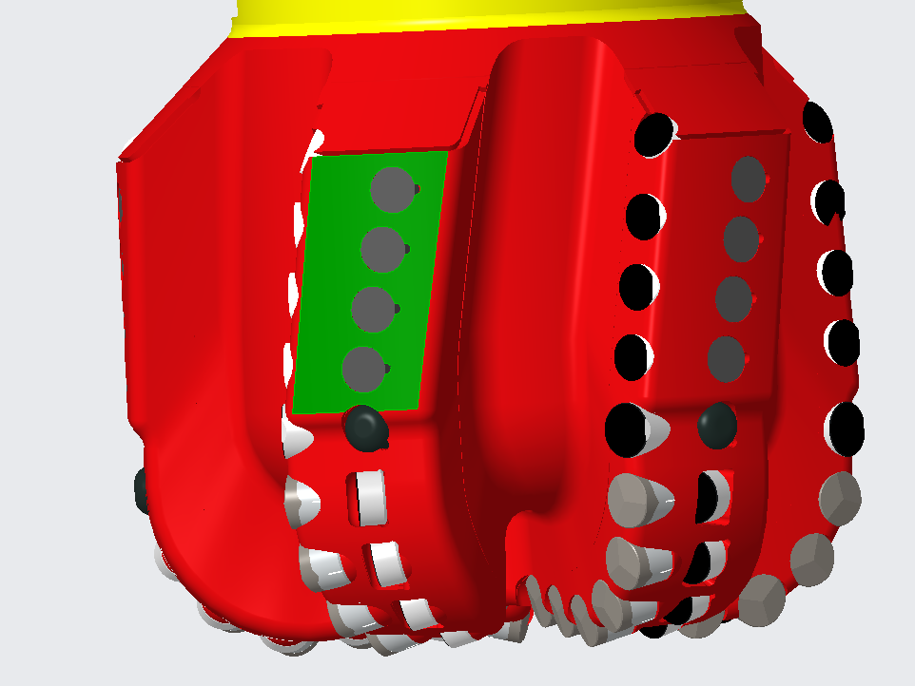
Bit Tagging
Tag gauge pad surface only (highlighted green in image)
Be sure to separate pads if grouped to ensure pads are assigned unique names
Open gauge pad surface group
Copy-paste (ctrl+c, ctrl+v) surface group
Options > "Exclude surfaces and Fill holes"
Using Ctrl+left click select surfaces elements to be deleted
Press delete key to remove excess surface elements
Repeat until each pad is its own unique surface group

Slide 11
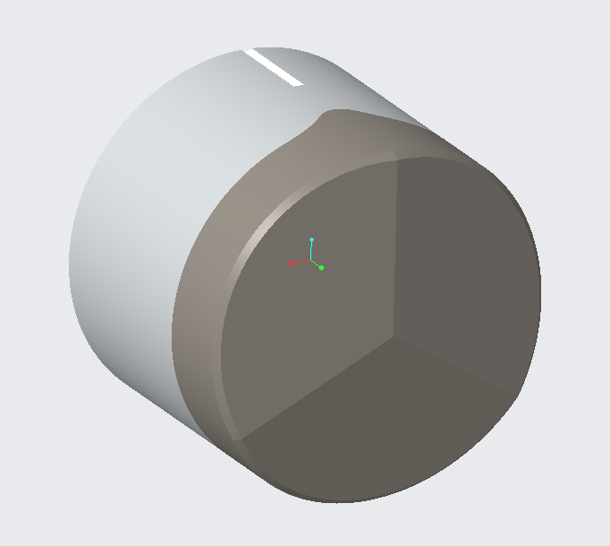
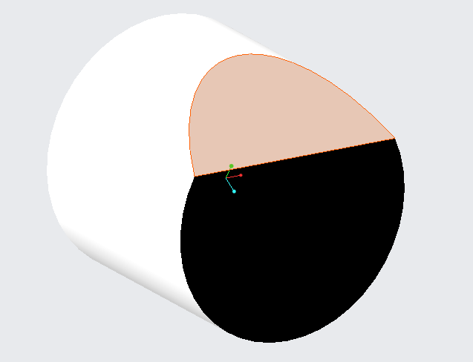
Cutter Tagging
Cutter body
(all remaining pieces not chamfer or face)
Tag cutter elements as shown in image
Cutter body
(all remaining pieces not chamfer or face)
Cutter chamfer (edge surface)
Cutter face
Cutter face

Slide 12
Last Slide

